Slide 1

WELLCOME
Binary Search

Slide 2
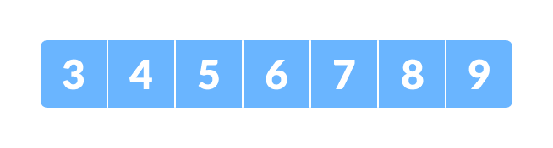
Binary Search is a searching algorithm for finding an element's position in a sorted array.
In this approach, the element is always searched in the middle of a portion of an array.
Binary search can be implemented only on a sorted list of items. If the elements are not sorted already, we need to sort them first.
Binary Search Working
Binary Search Algorithm can be implemented in two ways which are discussed below.
1.Iterative Method
2.Recursive Method
The recursive method follows the divide and conquer approach.
The general steps for both methods are discussed below.
1.The array in which searching is to be performed is:
Initial array Let x = 4 be the element to be searched.

Slide 3
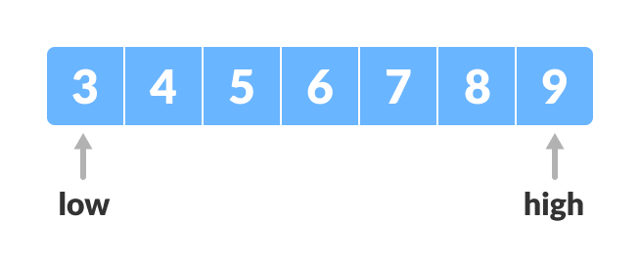
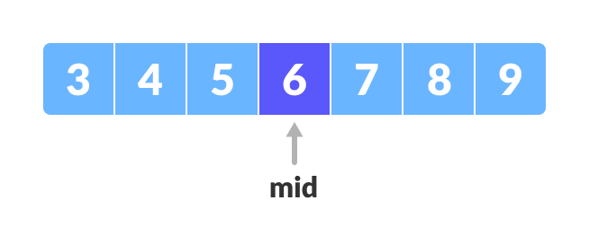
Set two pointers low and high at the lowest and the highest positions respectively.
Setting pointers
Find the middle position mid of the array ie. mid = (low + high)/2 and arr[mid] = 6. Mid element
Mid element

Slide 4
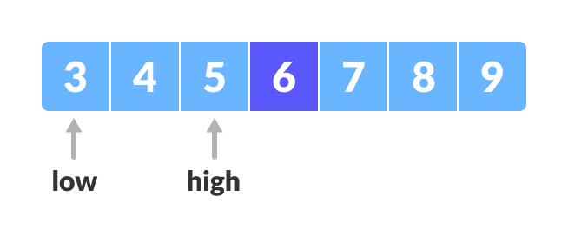
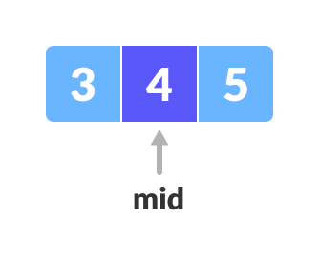
If x == arr[mid], then return mid. Else, compare the element to be searched with arr[mid].
If x > arr[mid], compare x with the middle element of the elements on the right side of arr[mid]. This is done by setting low to low = mid + 1.
Else, compare x with the middle element of the elements on the left side of arr[mid]. This is done by setting high to high = mid - 1.
Finding mid element
Mid element

Slide 5
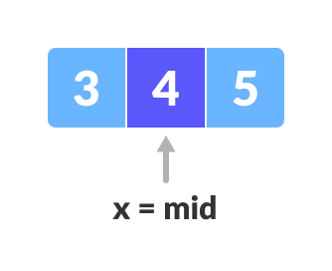
Repeat steps 3 to 6 until low meets high.
Found
x = 4 is found.
Binary Search Applications
In libraries of Java, .Net , C++ STL
While debugging, the binary search is used to pinpoint the place where the error happens.
THANK YOU
Presented by byteslides.com

